Slide 2
Community Budget Input Meetings
FY25 Budget Overview
May 7, 2024

Slide 3
Actual Changes in Fund Balance 3 Year Review
Major Operating Fund Balance Analysis | General Fund | Road & Drainage District | Fire Rescue District | Solid Waste District | Building Fund
Fiscal Year 2021 Beginning Fund Balance Revenues Expenditures Ending Fund Balance | $15,749,594 53,833,024 (48,966,767) $20,615,851 | $18,546,069 21,682,353 (15,792,148) $24,436,274 | $4,743,635 13,623,649 (12,157,700) $6,209,585 | $3,601,032 11,102,147 (9,026,267) $5,676,913 | $6,867,746 4,202,744 (3,871,853) $7,198,637
Fiscal Year 2022 Beginning Fund Balance Revenues Expenditures Ending Fund Balance | $20,615,851 57,981,611 (53,962,517) $24,634,945 | $24,436,274 21,350,625 (21,126,168) $24,660,731 | $6,209,585 14,359,493 (14,353,209) $6,215,868 | $5,676,913 11,551,878 (10,316,746) $6,912,045 | $7,198,637 5,669,738 (4,101,837) $8,766,537
Fiscal Year 2023 Beginning Fund Balance Revenues Expenditures Ending Fund Balance | $24,634,945 69,447,016 (65,553,598) $28,528,364 | $24,660,731 57,981,794 (70,306,681) $12,335,844 | $6,215,868 16,110,482 (15,096,714) $7,229,636 | $6,912,045 12,821,877 (13,230,688) $6,503,234 | $8,766,537 8,440,167 (5,885,579) $11,321,125

Slide 4
FY 2024 Fund Balance Analysis
Major Operating Fund Balance Analysis | General Fund | Road & Drainage District | Fire Rescue District | Solid Waste District | Building Fund
Fiscal Year 2024 Beginning Fund Balance Budgeted (Use) or Reserve of Fund Balance Committed Fund Balance-Amendments, Reappropriated Projects and Encumbrances Emergency & Disaster Reserve (20%) Projected “Available” Fund Balance | $28,528,364 367,730 (6,253,847) (14,892,518) $7,749,729 | $12,335,844 1,195,200 (24,407,931) (4,892,474) $(15,769,361) | $7,229,636 1,081,710 (4,277,410) (3,219,104) $814,832 | $6,503,234 (1,139,150) (448,000) (2,962,670) $1,953,414 | $11,321,125 (1,497,120) (2,758,786) (1,686,234) $5,378,985
Notes:
Road & Drainage anticipates $13,223,576 from hurricane reimbursements during FY 24

Slide 5
General Fund Ad Valorem Assumptions
Taxable value estimated increase of 7.5%
Budget ad valorem revenue at 96.5% collection rate
These assumptions will bring in an additional $2,321,560 at the same millage rate of 3.7667

Slide 6
All Funds
Utilize a factor of 3.5% salary growth of existing level of service and personnel.
Contracts for PBA and IAFF will be negotiated this year.
AFSCME will be budgeted same as non union employees.
Salary growth of 2.50% for cost of living adjustment for existing level of service and personnel (PBA, AFSCME and general employees
Cost impacts associated with capital projects
Ongoing staffing and operating costs
Maintenance
Notes:
CPI for Tampa-St Pete-Clearwater January 2024 is 3.9%

Slide 7
General Fund Changes 2024-2025
 | Estimate
Merit and Union Increases to Salaries | $1,873,700
CPI Adjustment of 2.5% | $965,300
Health Insurance | $580,100
Operating Costs Inflationary Increase | $1,997,800
Total | $5,416,900

Slide 8
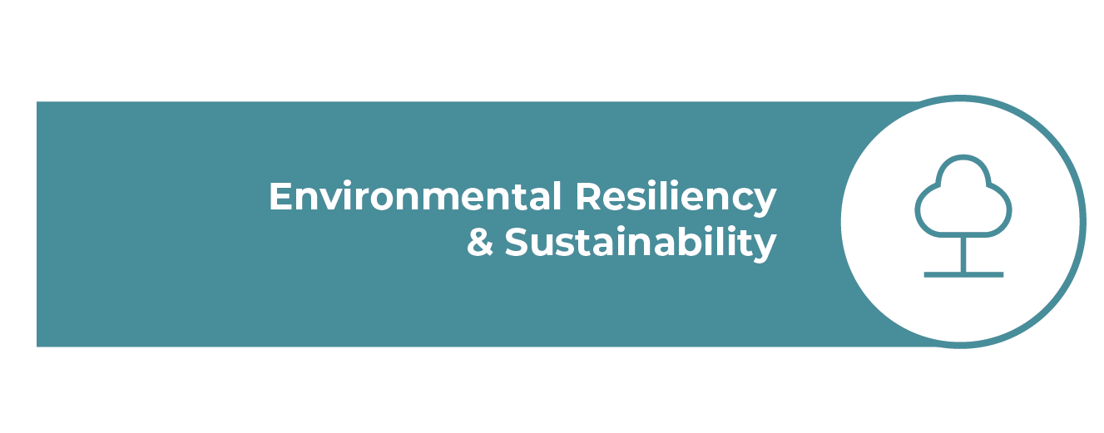
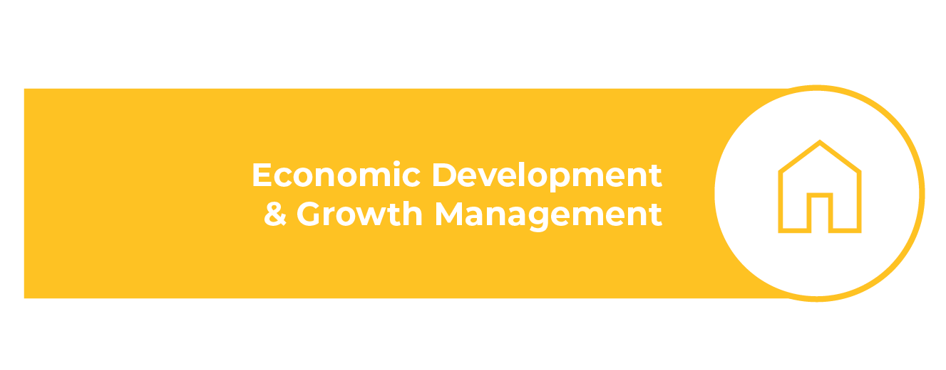
Defining Commission Priorities

Slide 9
FY 2024 Adopted Budget by Pillar All Funds

Slide 10
FY 2024 Adopted Budget by Pillar General Fund

Slide 11
ULDC update
Where we are in the process:
Chapter 5: Signs was presented to the City Commission on April 22.
Chapter 6: Natural Resources was presented to the City Commission on May 6.
First Reading of the companion Comprehensive Plan Amendments is anticipated at the end of May.
Full adoption of Comprehensive Plan and ULDC is anticipated at the end of June or beginning of July.
NorthPortFL.gov/Zoning

Slide 12
Need for commercial vs. residential taxes
Cities need 20 – 30% commercial / industrial land to be fiscally sustainable and to prevent residential taxpayers from shouldering the burden of infrastructure improvements and maintenance.
North Port has between 8- 11% because so much land was pre-platted as single-family in the 1950s – 1970s.
90% of North Port’s workforce travels outside our city to work.
The ULDC Rewrite proposes to convert single family land to job and tax producing uses along main road corridors and in the undeveloped eastern part of the City near a future I-75 interchange.

Slide 13
Economic Development: Gateway corridor study
Gateway Activity Center (I-75 and Sumter).
Study provides potential land use and stormwater mitigation alternatives to address future development, flooding, and environmentally sensitive areas.
Draft Alternatives were presented to City Commission on April 23.
Study will be complete in June.

Slide 14
Economic Development: Activity Center 6 study
I-75 and Yorkshire / Raintree area
Study will provide potential land use scenarios, job growth analysis, and transportation needs.
Proposed for Fiscal Year 2025.

Slide 15
Hospitals, other current efforts
Sarasota Memorial Hospital intends to break ground on both locations (I-75 & Sumter and Wellen Park) in 2025.
HCA broke ground on a new emergency facility in May.
Acadia Behavioral Healthcare is under construction.
Working on two potential commercial / entertainment districts along the Toledo Blade corridor.

Slide 16
Impact fees
City began charging full impact fees in 2022 (except for transportation – increase is pending due to State restrictions).
ALL new development is charged for Impact Fees.
Can only pay for infrastructure improvements that INCREASE capacity, such as new or widened roads, new turn lanes or traffic signals, new buildings or parks, new water / sewer lines, etc.
Cannot be used for maintenance or operating expenses, such as salaries, equipment replacement, repairs, etc.

Slide 17
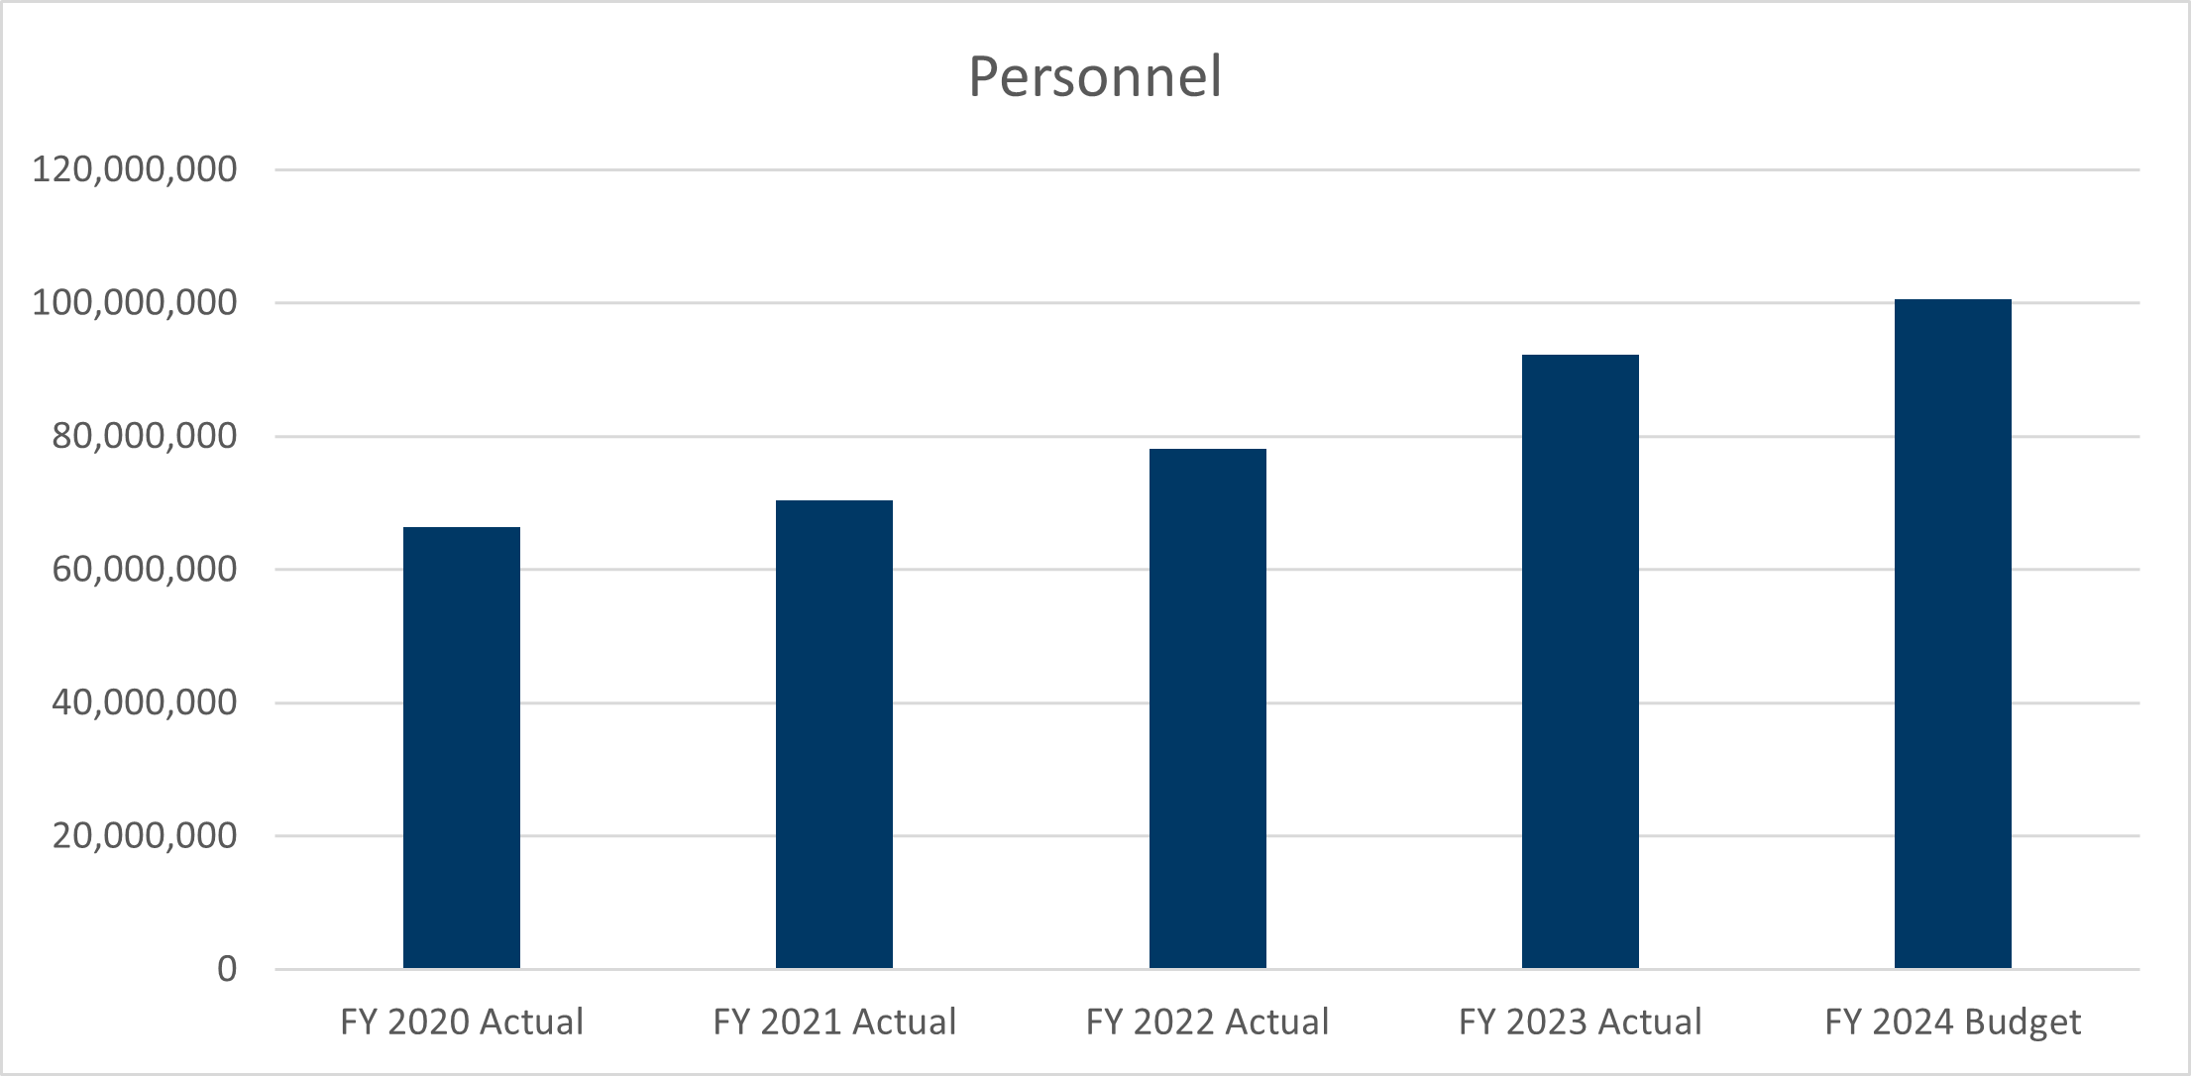
Total personnel costs
FY 20 – Salary Study
FY 22 – Additional 1% CPI for minimum wage adjustment year 1
FY 23 – 5% market adjustment
FY24 – increased Police salary tables
Increased staffing
Increased health care costs/prescriptions
Maintaining the same level of benefits for recruiting and retention of employees.
Tight Job Market

Slide 19
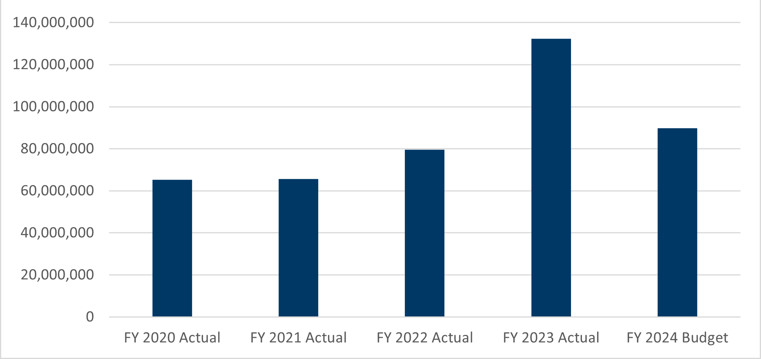
Operating Costs
FY 22 – $6.6m increase in Road Rehab in R&D, $3m increase in medical claims
FY 23 – Hurricane Ian
Property insurance is a hard market
Limited insurance providers for an organization our size of Total Insured Value
Catastrophic claims with regards to weather

Slide 20
Local Municipalities & Counties

Slide 21
City Manager’s Considerations
Low New Employee Requests
Incremental Millage Rate Increase
New Enterprise Resource Planning (ERP) System
Charter Amendment – Borrowing Authority
New Police Headquarters
Capital Improvement Project (CIP) Rearrangement
Surtax Project List Rearrangement
Resilient SRQ Grant Infrastructure Program
Water Control Structures
Financial Support to Community Projects
New YMCA Building on King Plastics’ Property
Suncoast Technical College Expansion (Phase 3)

Slide 22
Questions?

